Slide 1
R-04 To resolve boot failure or the system shutdown occasionally
NVL-S RVP
Required Rework Document

Slide 2
R-04
To resolve boot failure or the system shutdown occasionally
Change Log | 2025 WW35 - Initial
Description | To resolve boot failure or the system shutdown occasionally
Impact | The board will be boot normally
Rework Involved | Resistors and blue wires
SKUs | S-041 FAB1
Contacts | Chen, Ellen ; Wang, Ivan B
HSD Link | N/A
Collateral Link | N/A
SW Dependency | N/A

Slide 3
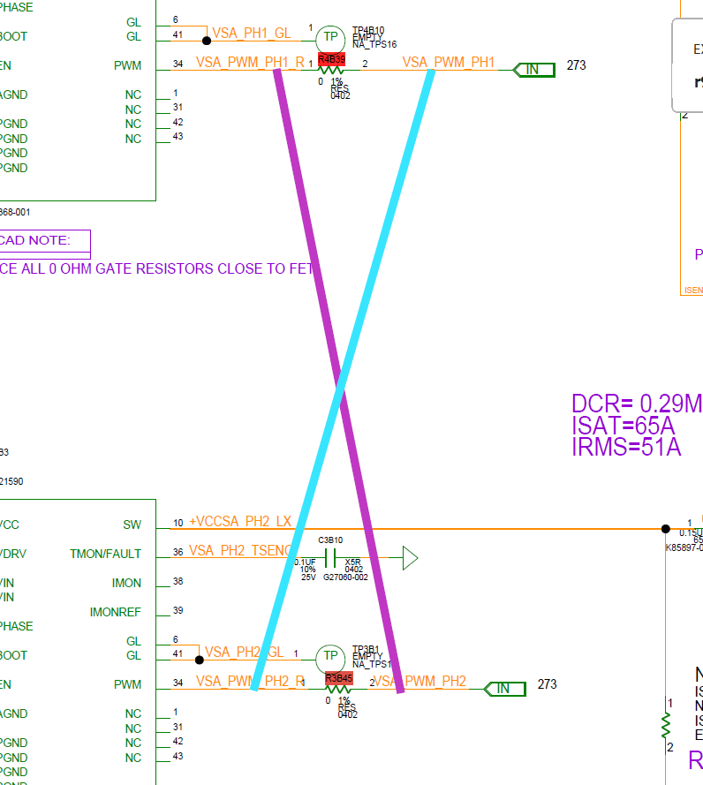
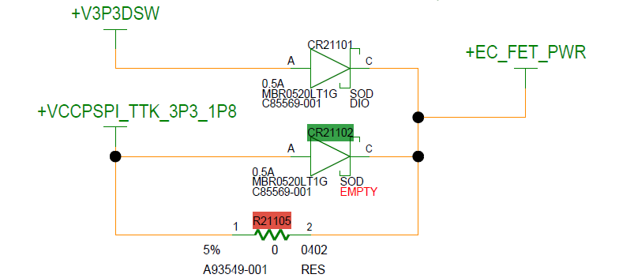
NVL-S RVP S-041 Top

Slide 4
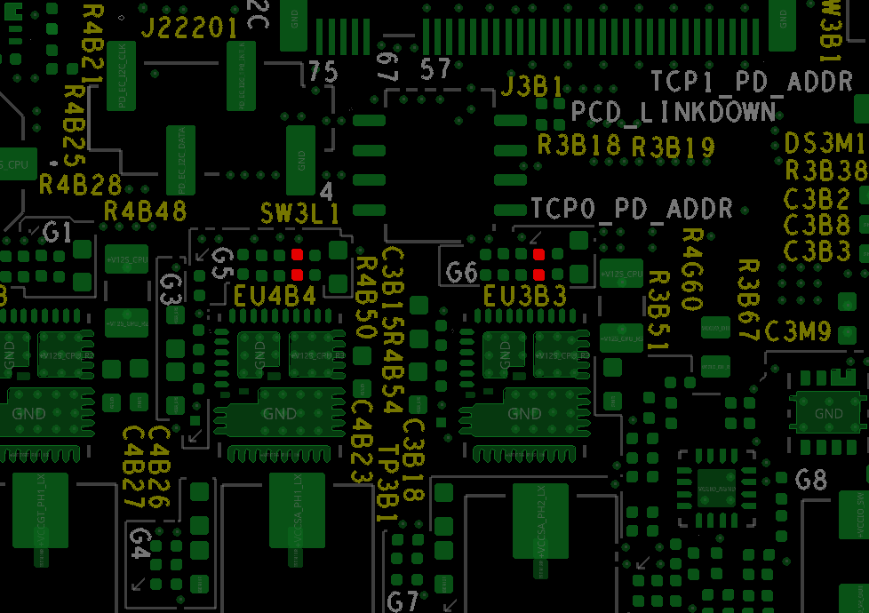
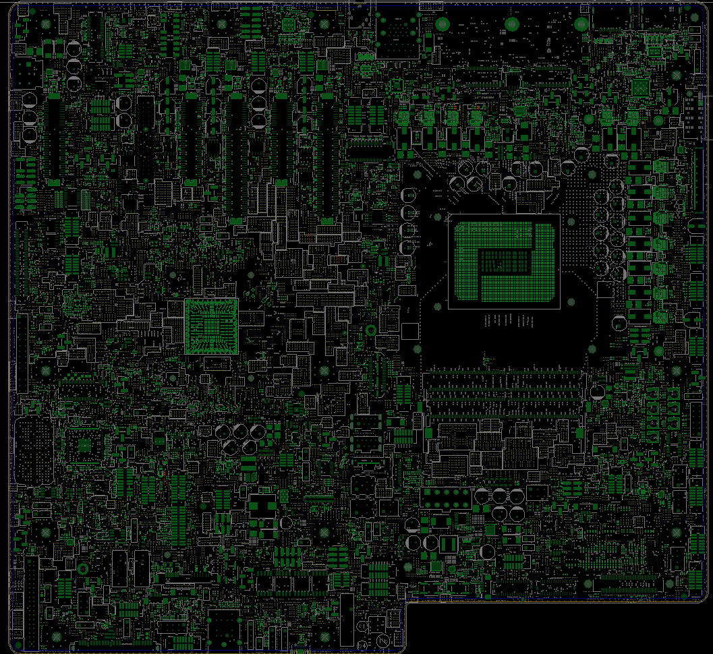
NVL-S RVP S-041
Step 1 of 2
Action | REFDES | Description
UNSTUFF | R4B39,R3B45 | RES D,0402,0.00 OHM,5.00%,1/16W
Blue wire | 1. Add a blue wire between R4B39.1 and R3B45.2 2. Add a blue wire between R4B39.2 and R3B45.1
R3B45 pin2
R4B39 pin2
TOP
R3B45 pin1
R4B39 pin1

Slide 5
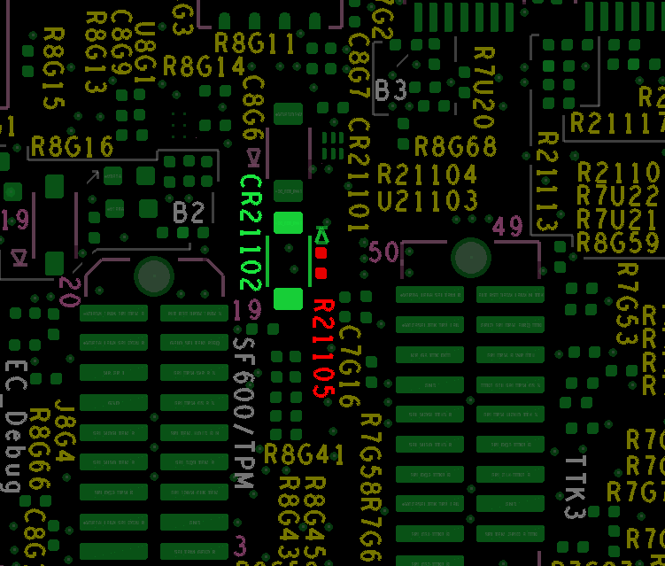
NVL-S RVP S-041
Step 2 of 2
Action | REFDES | Description
UNSTUFF | R21105 | RES D,0402,0.00 OHM,5.00%,1/16W
STUFF | CR21102 | IC,DS,DIO,SOD123,MBR0520LN,SHTKY
C
C
TOP
A
A

Slide 6
NVL-S RVP S-041
R-04 To resolve boot failure or the system shutdown occasionally
Rework Summary
Action | Item | REFDES | Current IPN | Description | New IPN | Description
UNSTUFF | Resistor | R4B39,R3B45 | N14522-001 | RES_D,0402,0OHM,1%,1/16W | NA | NA
Blue Wire | NA | NA | NA | NA | 1. Add a blue wire between R4B39.1 and R3B45.2 2. Add a blue wire between R4B39.2 and R3B45.1
UNSTUFF | Resistor | R21105 | N14522-001 | RES_D,0402,0OHM,1%,1/16W | NA | NA
STUFF | NA | CR21102 | NA | NA | C85569-001 | IC,DS,DIO,SOD123,MBR0520LN,SHTKY

